Slide 1
Society Management System
Vineet Rao -161070001
Vinayak Borhade -161070004
Ameya Daddikar -161070015

Slide 2
Table of Contents
Abstract
Problem Statement
Current System
Limitations of Current System
Proposed System
Features
Design of System
UML Diagrams
User Interface
Future Scope
Conclusion

Slide 3
Abstract
Society Management System(SMS) offers you hassle-free platform to transform your society, making it highly functional and easily manageable. Handles society matters, it enables even a newcomer to participate in the management process. This software can handle Billing and Accounts related requirements of our clients. In a field where the Accountant / Manager normally changes along with a change in the Managing Committee.

Slide 4
Problem Statement
Create a web-based Housing Society Management solution for residential and commercial complexes & Housing Societies.

Slide 5
Current System
In a manual system, the committee has to maintain multiple registers or ledgers. Calculating and compiling the balance sheet at the end of each financial year, are hectic and most often have flaws. Consequently, there are repeated revisions and correcting.
WhatsApp and Facebook groups are not marked as a dedicated society management tool. Bigger the societies, more the number of WhatsApp groups. This system makes it difficult to track the official WhatsApp group.

Slide 6
Limitations of Current System
Managing Complex Audit data is Hectic
No dedicated communication platform available
Lack of Optimum Facilities Usage our society has to offer
Maintenance dues and defaulters Tracking
Security - visitor approvals, authentication, timely check-ins and checkouts

Slide 7
Proposed System

Slide 8
Proposed System - Working
Proposed system consists of
Society as unit
Society consists of wings, flats, facilities
People may login as members of the society
People not belonging to a society are outsiders
Members include ordinary members, committee, admin
Admin has more powers to update the system. Members may only view most things like bills, notices etc.
Members may only raise issues, book facilities etc. Power to handle it is in admin and committee
Authenticated access is provided to private info like bills

Slide 9
Features
Facility inventory
Facility timetable and booking
Bill view and payment
Notices announcement
Raise complaints
Book appointment with society admin, committee

Slide 10
DESIGN OF SYSTEM
System uses a client server mechanism
Web pages are used to access the system
Various privileges and authorizations are provided based on roles
Centralised system, to allow for cross-society features(book appointments etc.)

Slide 11
UML Diagrams

Slide 12
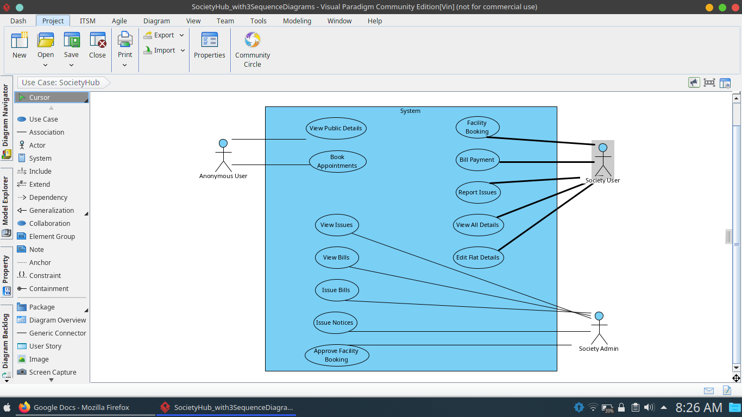
Use Case Diagram

Slide 13
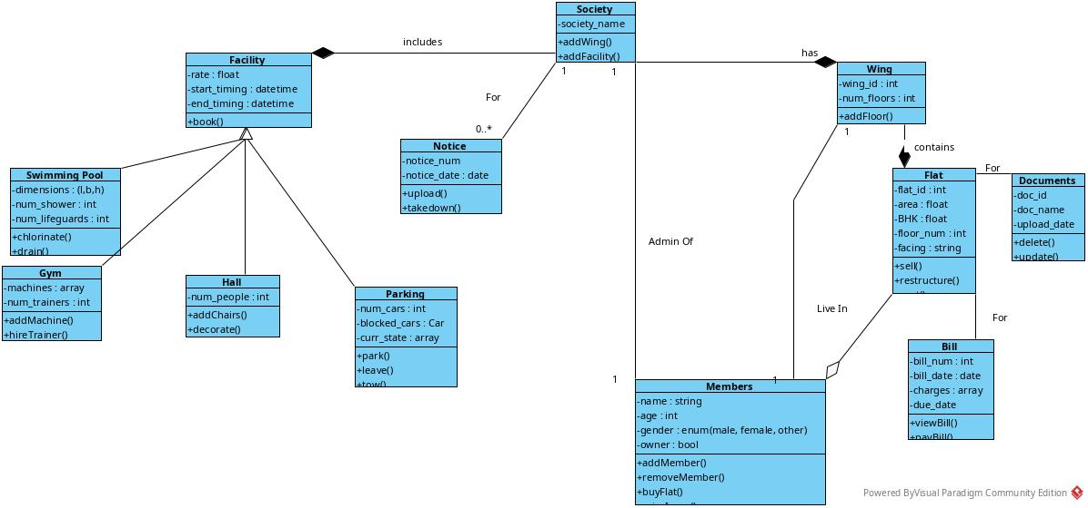
Class Diagram

Slide 14
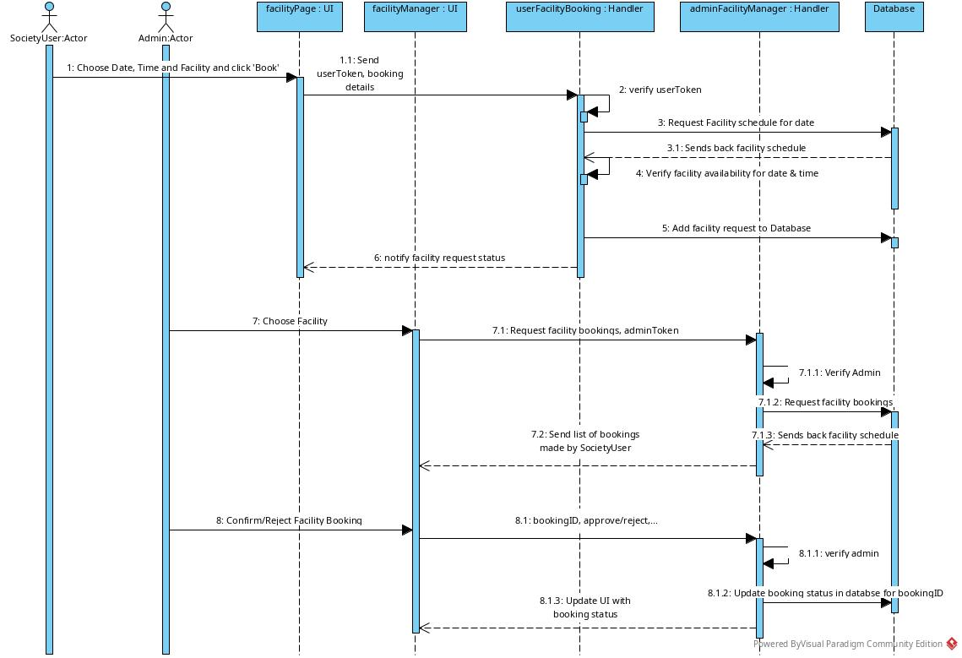
Sequence Diagram
Facility Booking

Slide 15
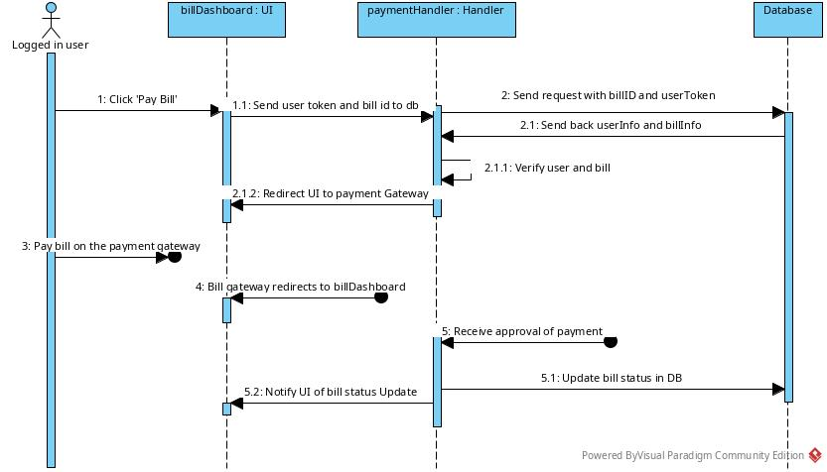
Sequence Diagram
Bill Payment

Slide 16
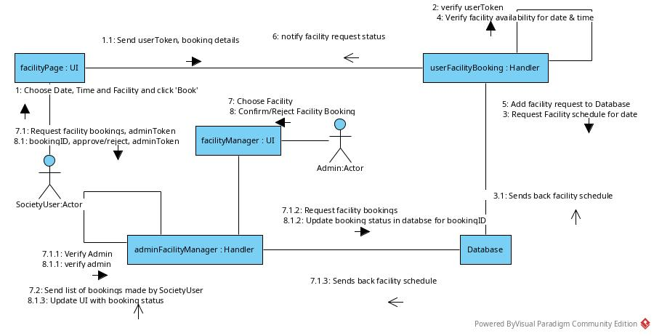
Collaboration Diagram - Facility Booking

Slide 17
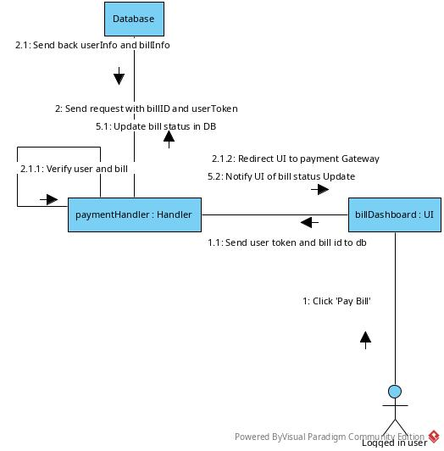
Collaboration Diagram
Bill Payment

Slide 18
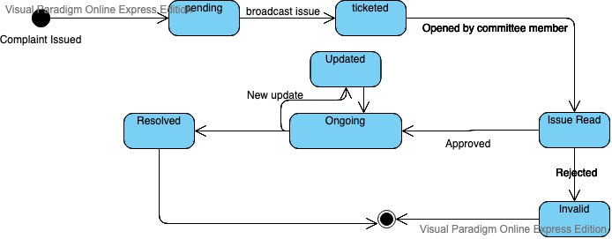
State Transition Diagram

Slide 19
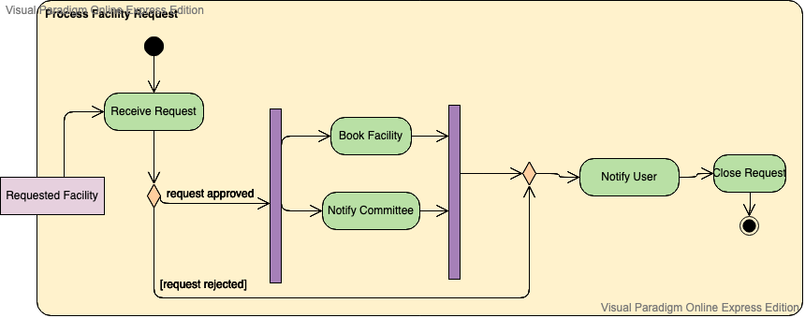
Activity Diagram

Slide 20
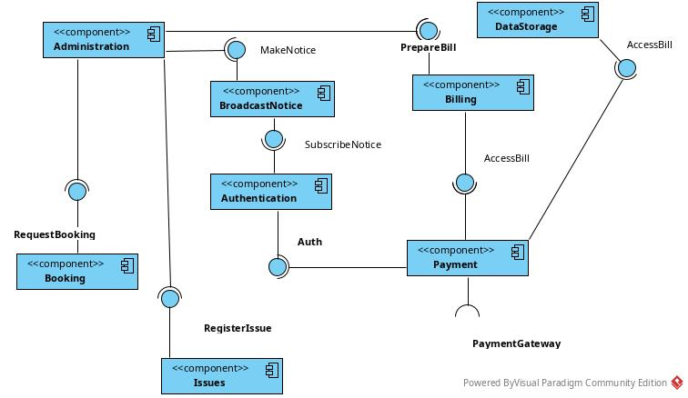
Component Diagram

Slide 21
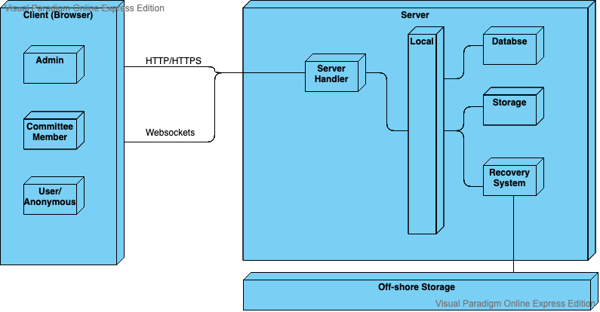
Deployment Diagram

Slide 22
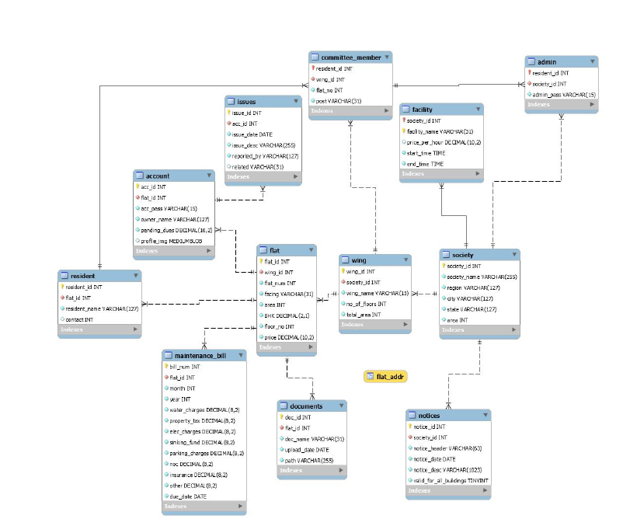
RELATIONAL

Slide 23
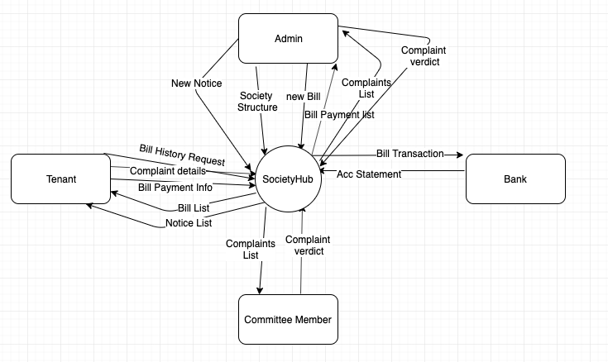
Data Flow Diagram (Level - 0)

Slide 24
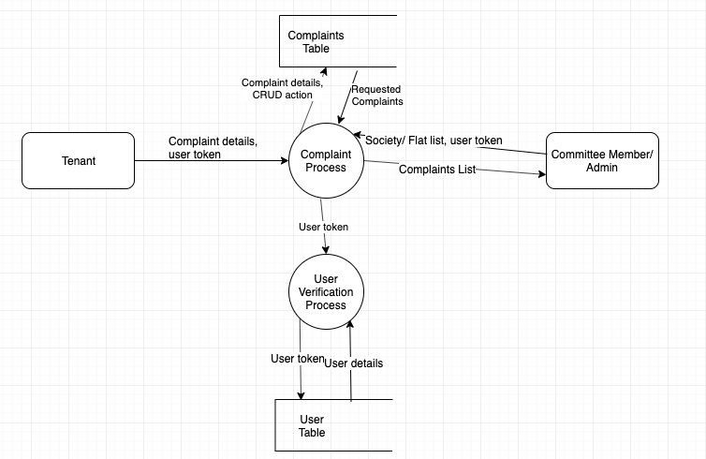
Data Flow Diagram (Level - 2)

Slide 25
USER INTERFACE

Slide 26
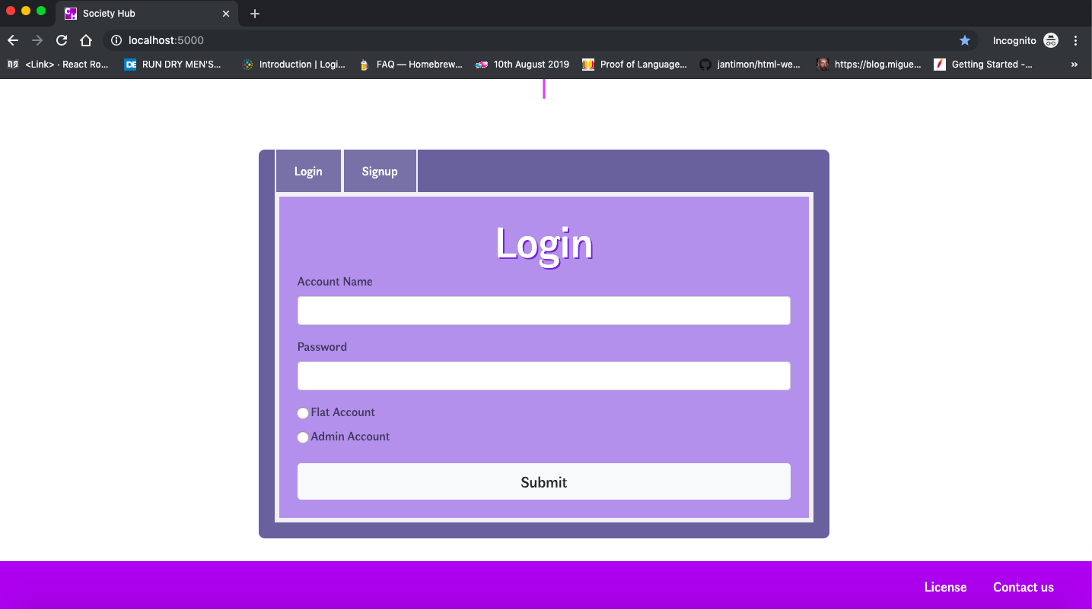
Login Screen

Slide 27
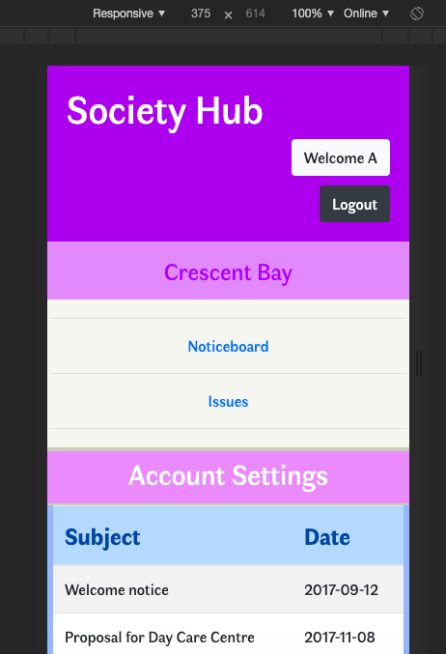
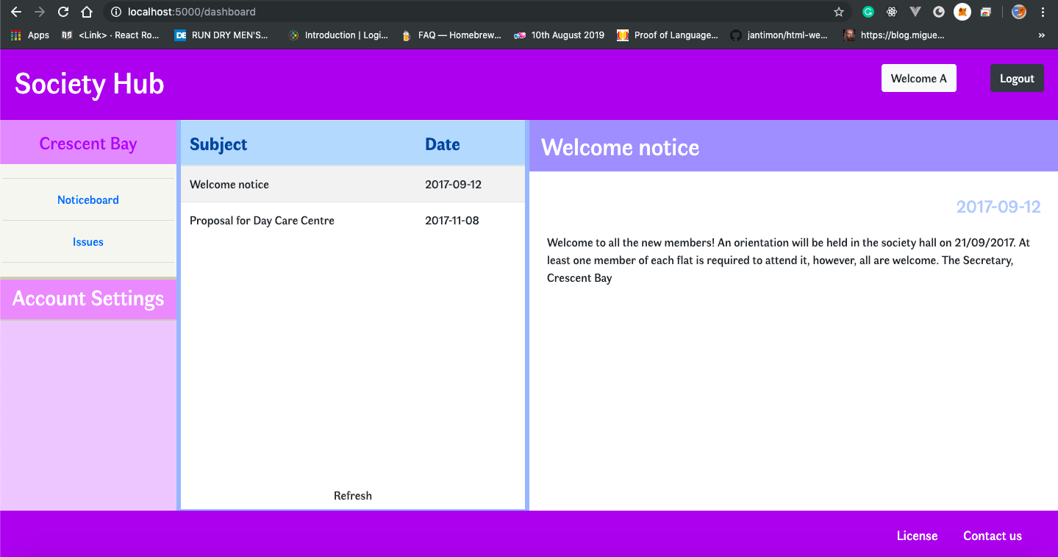
Noticeboard Page

Slide 28
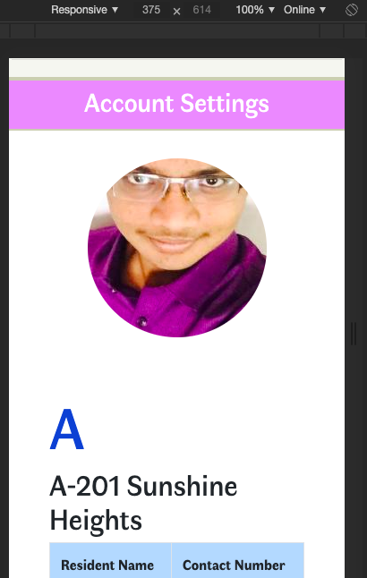
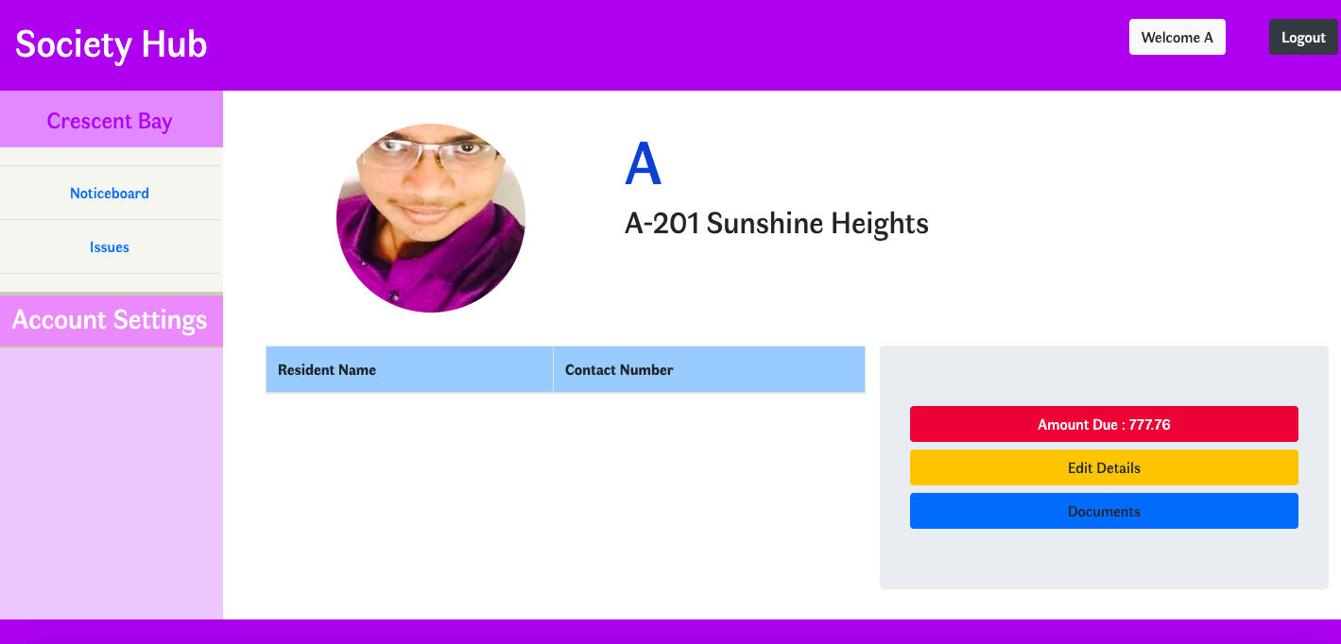
Account Page

Slide 29
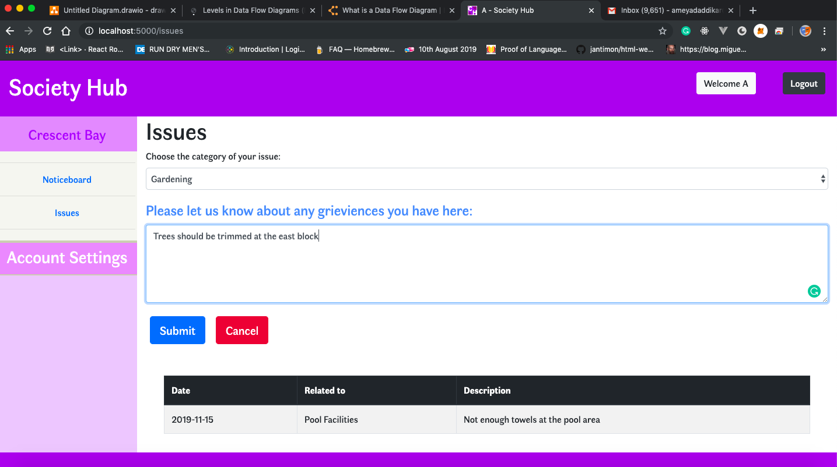
Issues Page

Slide 30
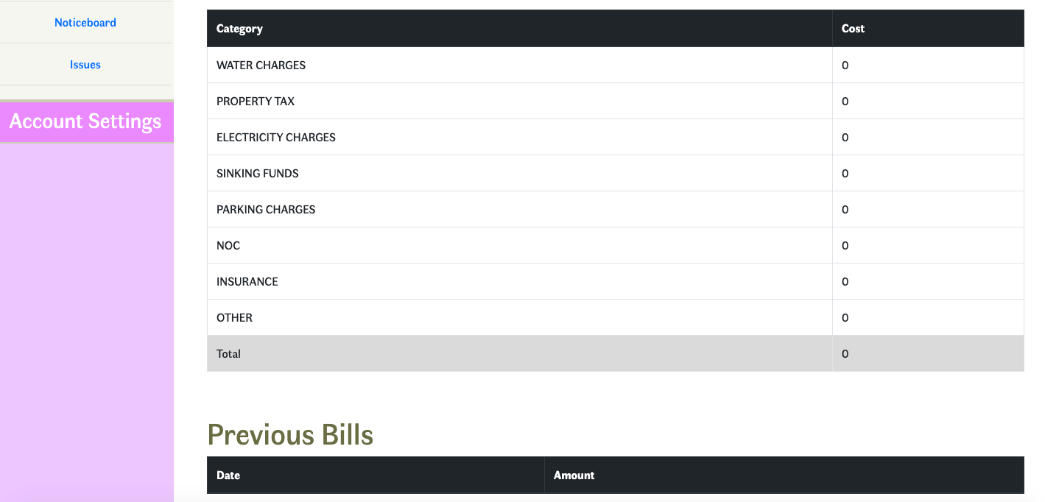
Bill Page

Slide 31
Future Scope
Additional features:
Connection to government systems to allow verification
More decentralised system where user data may exist on user machines, with only entries on central system
Full payment system with banks
Connection with social media to provide more interesting uses

Slide 32
Conclusion
Technology and humans – both have their limits. Technology needs monitoring and feeding of data into it, to work. Humans are prone to fallacies and exhaustion. Home is the place where we escape after a hard day’s work. Home is where we rest. If managing our home, starts to feel like a burdensome chore, we lose that one abode of peace in our lives. Hence, if a simple system can help ease some of that burden, then why not give it a shot?
Thus we have implemented such System as mini-project and covered the minimalistic features/requirements for Society Management.

Slide 33
Thank you!!

